Slide 1

Electric Field Analysis of 9-Tonne Railway Insulator by Finite Element Method
By
K.Mounika(18021D0803)
M.Tech (High Voltage Engineering)
Under the Esteemed Guidance of
Dr. M.Nageswara Rao M.Tech., Ph.D
University College of Engineering(A) Kakinada
JNTU Kakinada

Slide 2
Module 1 | Literature Review | Study of RDSO specification for railway insulators. Study of various IEC and IS standards. Numerical Methods. FEMM-2D Software Study of various pollutions exits in the environment and their severity. | Completed
Module 2 | Design of 9-tonne Polymer Insulator | Geometrical Configurations of Polymer insulator Design of insulator model Polluted zone (ie.,Creapage Distance: 1050mm) Very Heavy Polluted zone (ie.,Creapage Distance: 1600mm) Electrical Field Intensity Results at critical regions of the insulator. Results Comparison. | Completed
Module 3 | Evaluation of Insulator Performance under various Contaminations | Polluted zone insulator Cement Contamination Urea Contamination Salt Contamination Very heavy polluted zone insulator Cement Contamination Urea Contamination Salt Contamination Electrical Field Intensity Results at critical regions of the insulator. Results Comparison. | Completed
Module 4 | Evaluation of Insulator Performance with water molecules | Polluted zone insulator With equal water molecules With unequal water molecules Very heavy polluted zone insulator With equal water molecules With unequal water molecules Electrical Field Intensity Results at critical regions of the insulator. Results Comparison. | Completed

Slide 3
Module 5 | Evaluation of Insulator Performance with water molecules and under various Contaminations | Polluted zone insulator With Salt contamination and equal water molecules With Salt contamination and unequal water molecules With Cement contamination and equal water molecules With Cement contamination and unequal water molecules With Urea contamination and equal water molecules With Urea contamination and unequal water molecules Very heavy polluted zone insulator With Salt contamination and equal water molecules With Salt contamination and unequal water molecules With Cement contamination and equal water molecules With Cement contamination and unequal water molecules With Urea contamination and equal water molecules With Urea contamination and unequal water molecules Electrical Field Intensity Results at critical regions of the insulator. Results Comparison. | Completed
Module 6 | Results Comparison and Documentation | Electrical Field Intensity Results Comparison Documentation. | Completed

Slide 4
Objective
25kV 9-Tonne polymer railway insulator designed using FEMM 2D software package.
Electric field analysis(EFA)is to be carried in the following cases:
Polluted zone (ie.,1050mm Creepage Distance)
Very Heavy Polluted zone (1600mm Creepage Distance)
Electrical Field Intensity Results at critical regions of the insulator Compared.
Various pollution contaminations and water molecules are on the polymer insulator tested and compared by using FEMM 2D software package.

Slide 5
Introduction:
Insulators for railway traction applications are a category apart from the regular insulators as they demand extremely stringent performance and safety requirements.
Indian railways network typically uses three major types of insulators using composite and porcelain material they are: Stay Arm, Bracket tube and 9 Tonne insulators.
In this work, 9 tonne railway polymer insulators are designed and electric field intensity is analysed with the help of FEMM-2D software package. This software analyses the field intensity with the help of Finite Element Method.
In this work, two pollution zone insulators are considered (ie.1050mm and 1600mm creepage distance) Polluted and very heavy polluted zone insulators will be designed with FEMM-2D software package and various pollution performances are also analysed for an insulators.

Slide 6
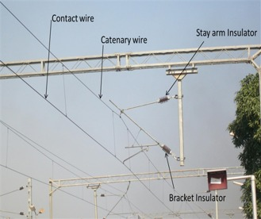
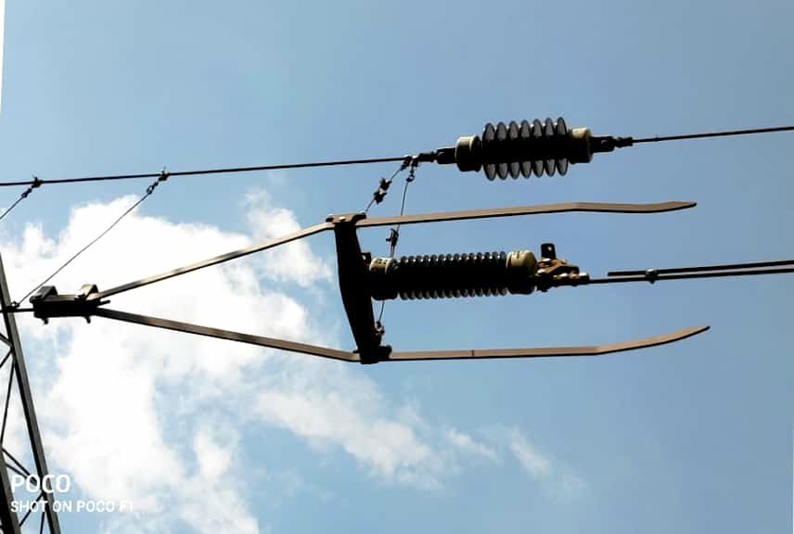
9-Tonne Insulator:
Used at each end of a 1.5 km section of weight-tensioned catenary. As the name implies, this has to withstand the combined tension forces in the catenary and contact wires .
It is also used in a vertical position to support 25kv feeder wire

Slide 7
Pollution exists in environment and their severity:
Exposed insulators are subject to surface dirt deposits to some degree in all operating areas. Fog, mist, or light rain can usually create conditions that produce a conducting film on the dirty insulator surface, without washing the impurities from the surface.
These contaminants are distinguished primarily by the source of the impurities. Local agricultural, industrial, and geographic conditions determine what are present in the atmosphere.
The various types of contaminants identified include salt, cement/lime, dusts, bird excrement, chemicals, smog (automobile emissions), cooling tower effluents, smoke, and organic and ice/snow. Ordinarily, wind and rain provide sufficient washing action to remove most of the common deposits.
More than one of these contaminants may be deposited on a group of insulators at a particular location. The mix and rates of deposit of these contaminants determine the characteristics of the mixture . Main parts of disc, glass and ceramic insulators .
Insulator pollution by bird excreta
dust settlement on the surface and inside of insulators

Slide 8
Polluted zone(CD-1050mm) i.e. 20mm/kV
These insulators shall be used in the areas, where equivalent salt deposit (ESDD) is <=0.3mg/sq.cm.
Very Heavy Polluted zone(CD-1600mm) i.e. 31mm/kV
These insulators shall be used in heavily/ very heavily polluted zones , where equivalent salt deposit density (ESDD) is more than 0.3 mg/sq.cm.

Slide 9
2D Triangular elements:
2D triangular elements are assigned to the model.
These elements distributed throughout the model and its boundary.
By running the model, contours will form throughout and surrounding area of the model.

Slide 10
Module II
Design of 9-tonne Polymer Insulator

Slide 11
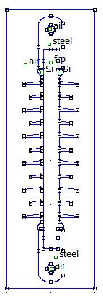
Geometrical configuration: a)Polluted zone insulator(CD-1050mm:20mm/kV):
Table 1:specifications of insulator
 | polluted zone (mm)
FRP Length | 450
Total Length | 600
FRP Diameter | 32
Core Diameter | 38
Pitch | 60
Big Shed diameter | 120
Small Shed diameter | 90
Fig 1:9-Tonne polymer insulator

Slide 12
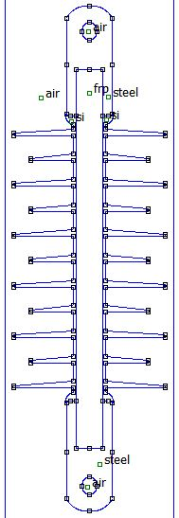
b)Very Heavy Polluted zone insulator(CD-1600mm:31mm/kV):
.
.
 | Very Heavy polluted zone (mm)
FRP Length | 450
Total Length | 600
FRP Diameter | 32
Core Diameter | 38
Pitch | 60
Big Shed diameter | 180
Small Shed diameter | 140
Table 2:specifications of insulator
Fig 2:very heavy polluted insulator

Slide 13
Material Properties :
Material | Relative permittivity
Air | 1
Steel | 1
FRP | 5
Si | 3
Table 3:materials properties insulator
Assigning Boundary Conditions:
Minimum wet power frequency withstand voltage 100kV to the energized high voltage end fitting and 0V to the grounded end fitting of the insulator.

Slide 14
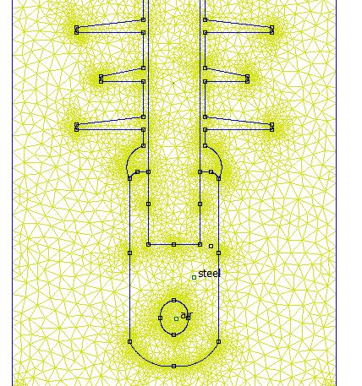
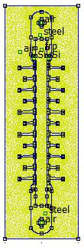
2D Triangular elements of Polluted zone insulator:
Fig 3: 2D triangular elements
Fig 4: at HV end

Slide 15
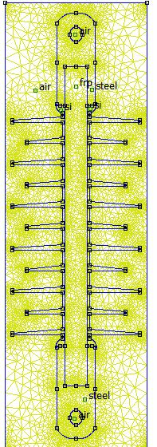
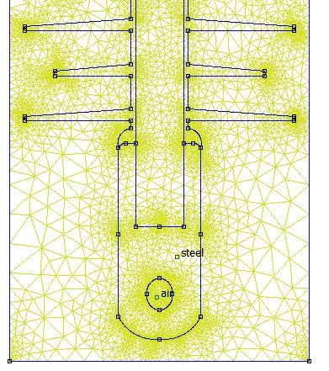
2D Triangular elements of very heavy polluted zone insulator:
Fig 6:at HV end
Fig 5: 2D triangular elements

Slide 16
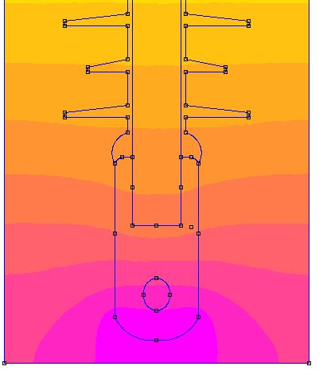
Polluted zone EFI results:
S.No | particulars | Electric Field Intensity(EFI) (kV/mm)
1 | CD | 0.217
2 | Triple Point | 0.284
3 | First Shed | 0.116
4 | Inside FRP | 0.348
5 | Inside Si | 0.144
Fig 7:contours at HV end
Table 4:EFI results

Slide 17
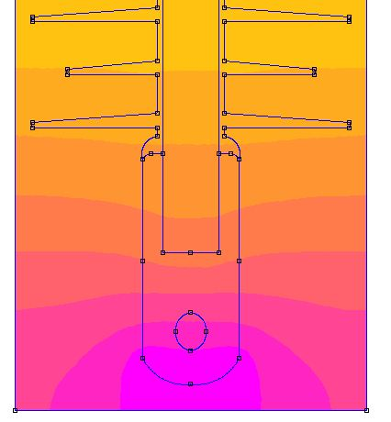
Very Heavy Polluted zone EFI results:
S.No | particulars | Electric Field Intensity(EFI) (kV/mm)
1 | CD | 0.207
2 | Triple Point | 0.231
3 | First Shed | 0.130
4 | Inside FRP | 0.348
5 | Inside Si | 0.145
Table 5:EFI results
Fig 8:contours at HV end

Slide 18
EFI Results Comparison:
S.No | particulars | Polluted zone kV/mm | Very Heavy Polluted zone kV/mm
1 | CD | 0.217 | 0.207
2 | Triple Point | 0.284 | 0.231
3 | First Shed | 0.116 | 0.130
4 | Inside FRP | 0.348 | 0.348
5 | Inside si | 0.144 | 0.145
Table 6:EFI results of polluted and very heavy polluted zone insulator.

Slide 19
Module III
Evaluation of Insulator Performance under various Contaminations

Slide 20
Material Properties :
Material | Relative permittivity
Cement | 2.7
Urea | 3.5
Salt | 6.1
Table 7:materials properties
Insulator Performance under various Contaminations:
a)Polluted zone insulator
1. Cement Contamination
2. Urea Contamination
3. Salt Contamination
b)Very heavy polluted zone insulator
1.Cement Contamination
2.Urea Contamination
3.Salt Contamination
For EFI analysis, considering the contamination on the insulator to be even and uneven with 1mm and 0.5 thickness.

Slide 21
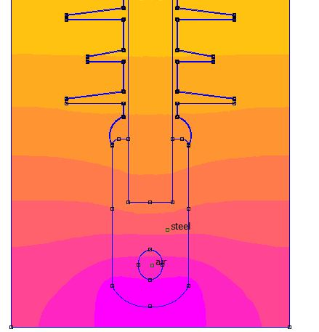
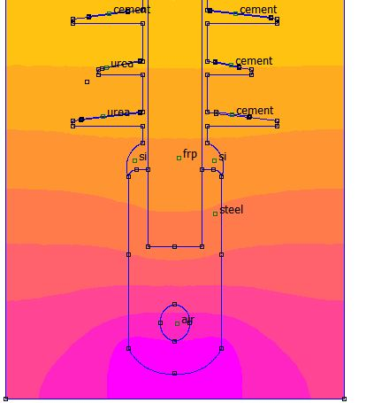
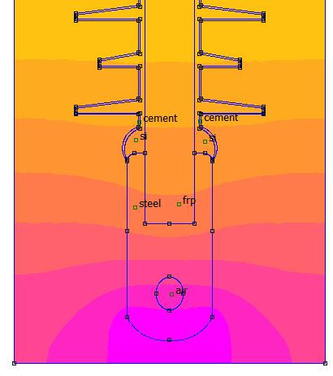
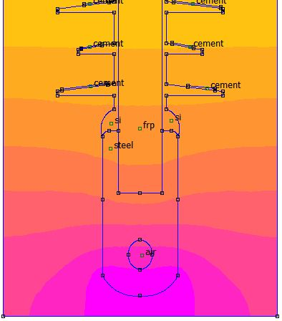
a)Polluted Zone :
1.Cement contamination
Fig 9:contours for even 0.5mm thickness contamination
Fig 11:contours uneven 0.5mm thickness contamination
Fig 10:contours for even 1mm thickness contamination
Fig 8:contours for uneven 1mm thickness contamination

Slide 22
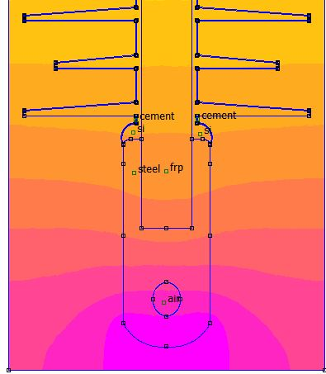
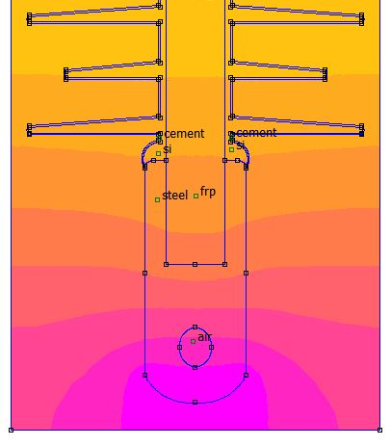
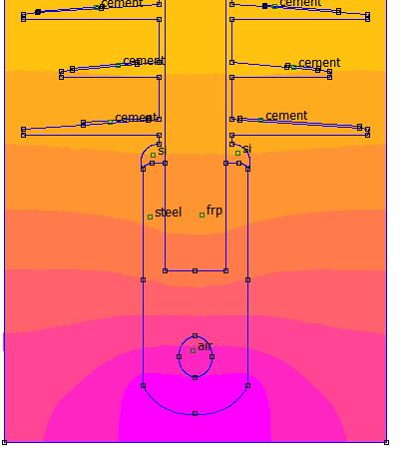
a) Very Heavy Polluted Zone :
1.Cement contamination
Fig 13:contours for even 0.5mm thickness contamination
Fig 15:contours for even 1mm thickness contamination
Fig 14:contours for uneven 0.5mm thickness contamination
Fig 16:contors for uneven 1mm thickness contamination

Slide 23
EFI Results:
 | CD | TRIPLE POINT | FIRST SHED
1050mm | 0.217 | 0.284 | 0.116
1600mm | 0.207 | 0.231 | 0.130
S.No | particulars | Polluted zone |  |  |  | Very heavy polluted zone
 |  | 0.5mm Even ctmn | 1mm Even ctmn | 0.5mm uneven ctmn | 1mm uneven ctmn | 0.5mm Even ctmn | 1mm Even ctmn | 0.5mm uneven ctmn | 1mm uneven ctmn
1 | CD | 0.241 | 0.244 | 0.229 | 0.232 | 0.224 | 0.226 | 0.218 | 0.220
2 | Triple Point | 0.184 | 0.172 | 0.276 | 0.270 | 0.185 | 0.146 | 0.239 | 0.238
3 | First shed | 0.136 | 0.136 | 0.142 | 0.142 | 0.144 | 0.144 | 0.145 | 0.145
Table 8:EFI results of insulator with cement contamination

Slide 24
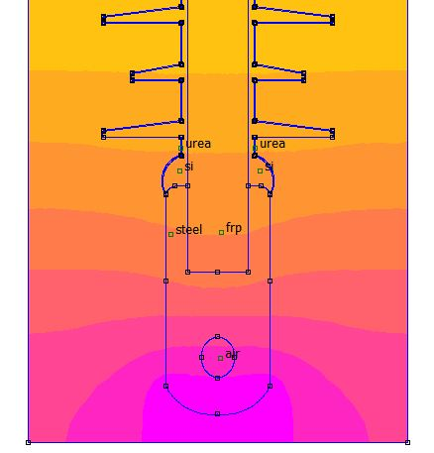
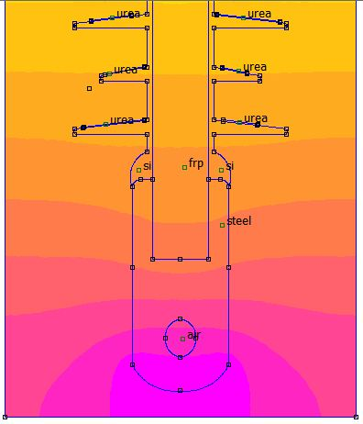
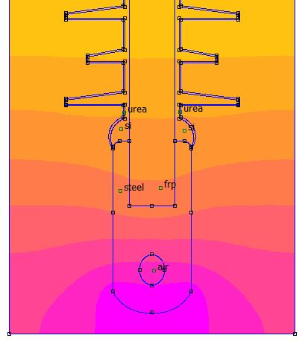
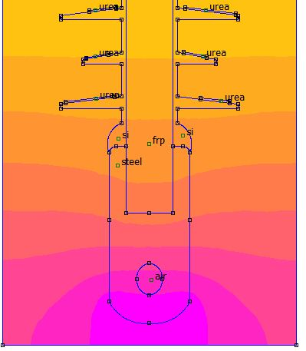
a 2)Urea contamination
Fig 17:contours for even 0.5mm thickness contamination
Fig 19:contours for uneven 0.5mm thickness contamination
Fig 18:contours for even 1mm thickness contamination
Fig 20:contours for uneven 1mm thickness contamination

Slide 25
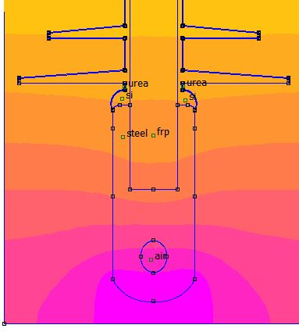
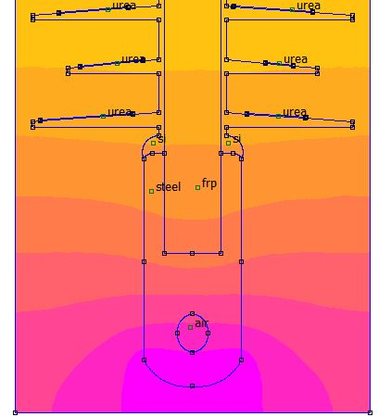
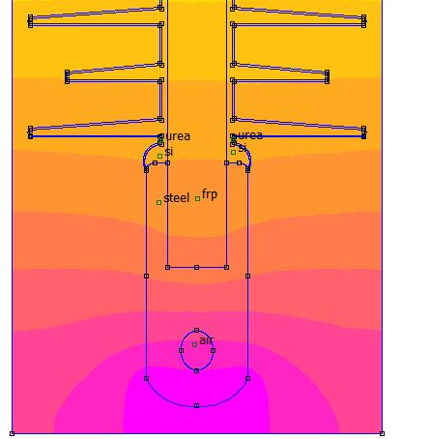
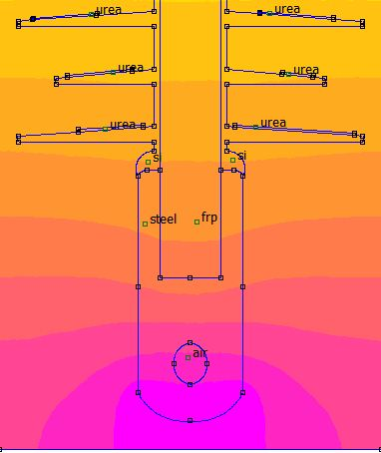
b 2) Urea contamination
Fig 21:contours for even 0.5mm thickness contamination
Fig 23:contours for uneven 0.5mm thickness contamination
Fig 22:contours for even 1mm thickness contamination
Fig 24:contours for uneven 1mm thickness contamination

Slide 26
EFI Results:
 | CD | TRIPLE POINT | FIRST SHED
1050mm | 0.217 | 0.284 | 0.116
1600mm | 0.207 | 0.231 | 0.130
S.No | particulars | Polluted zone |  |  |  | Very heavy polluted zone
 |  | 0.5mm Even ctmn | 1mm Even ctmn | 0.5mm uneven ctmn | 1mm uneven ctmn | 0.5mm Even ctmn | 1mm Even ctmn | 0.5mm uneven ctmn | 1mm uneven ctmn
1 | CD | 0.266 | 0.276 | 0.253 | 0.259 | 0.235 | 0.252 | 0.224 | 0.227
2 | Triple Point | 0.164 | 0.150 | 0.278 | 0.270 | 0.172 | 0.159 | 0.239 | 0.238
3 | First shed | 0.132 | 0.139 | 0.142 | 0.142 | 0.140 | 0.144 | 0.142 | 0.144
Table 9:EFI results of insulator with urea contamination

Slide 27
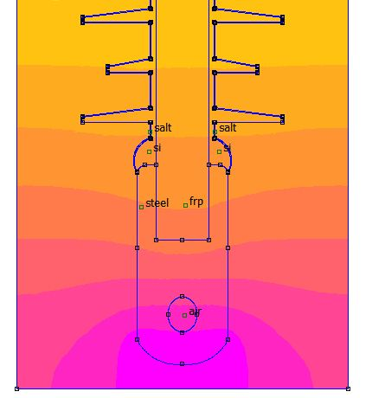
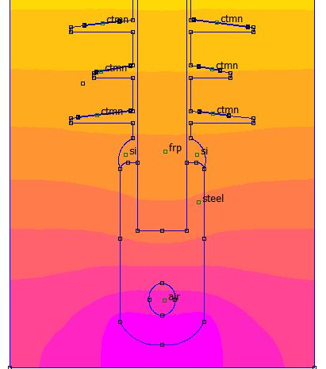
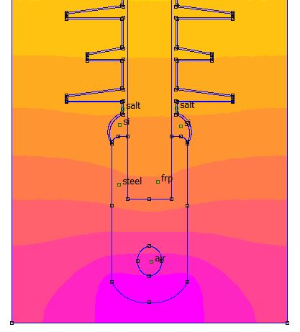
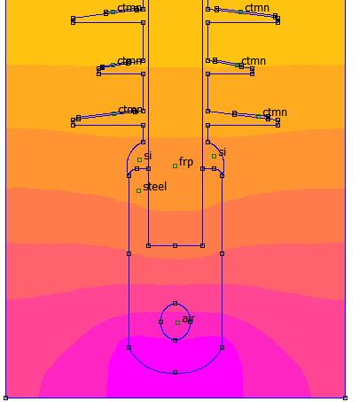
a3) Salt contamination
Fig 25:contours for even 0.5mm thickness contamination
Fig 27:simulation results for uneven 0.5mm thickness contamination
Fig 28:simulation results for uneven 1mm thickness contamination
Fig 26:simulation results for even 1mm thickness contamination

Slide 28
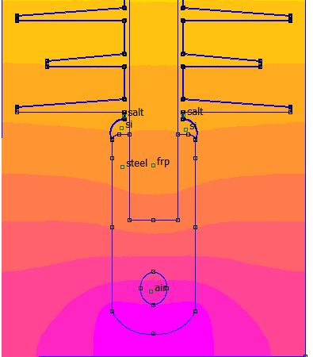
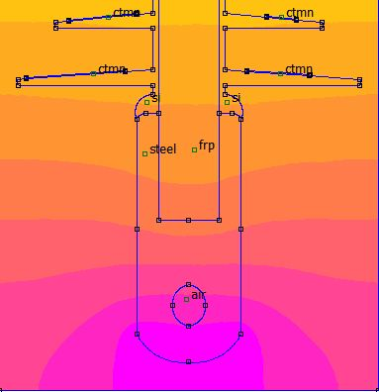
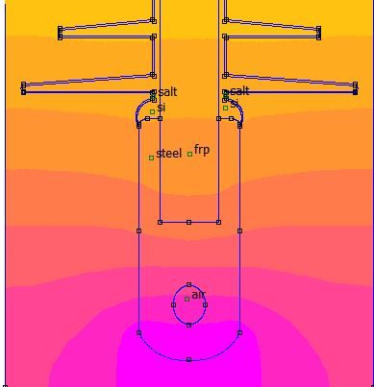
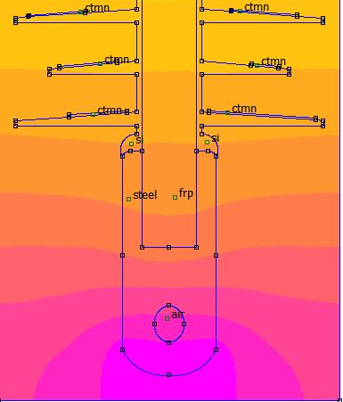
b 3)Salt contamination
Fig29:contours for even 0.5mm thickness contamination
Fig31:contours for uneven 0.5mm thickness contamination
Fig30:contours for even 1mm thickness contamination
Fig32:contours for uneven 1mm thickness contamination

Slide 29
EFI Results:
 | CD | TRIPLE POINT | FIRST SHED
1050mm | 0.217 | 0.284 | 0.116
1600mm | 0.207 | 0.231 | 0.130
s.No | particulars | Polluted zone |  |  |  | Very heavy polluted zone
 |  | 0.5mm Even ctmn | 1mm Even ctmn | 0.5mm uneven ctmn | 1mm uneven ctmn | 0.5mm Even ctmn | 1mm Even ctmn | 0.5mm uneven ctmn | 1mm uneven ctmn
1 | CD | 0.328 | 0.360 | 0.258 | 0.261 | 0.288 | 0.316 | 0.230 | 0.234
2 | Triple Point | 0.129 | 0.112 | 0.273 | 0.274 | 0.146 | 0.131 | 0.233 | 0.233
3 | First shed | 0.130 | 0.141 | 0.148 | 0.146 | 0.142 | 0.149 | 0.148 | 0.149
Table 10:EFI results of an insulator with salt contamination

Slide 30
Results Comparison:
a)EFI (kV/mm): Without Contamination
Particular | 1050mm | 1600mm
CD | 0.217 | 0.207
b)EFI (kV/mm): With even contamination
S.No | SALT | UREA | CEMENT
1050:0.5 mm | 0.328 | 0.266 | 0.241
1050: 1mm | 0.360 | 0.276 | 0.244
1600: 0.5 mm | 0.288 | 0.235 | 0.224
1600: 1mm | 0.316 | 0.252 | 0.226
c)EFI (kV/mm): With uneven contamination
S.No | SALT | UREA | CEMENT
1050:0.5 mm | 0.258 | 0.253 | 0.229
1050: 1mm | 0.261 | 0.259 | 0.232
1600: 0.5 mm | 0.230 | 0.224 | 0.218
1600: 1mm | 0.234 | 0.227 | 0.220
Table 11, 12 & 13:EFI results of an insulator without and with different contaminations
From the above table, the EFI of insulator with even contamination is about 51%,22% and 11% more compared to the insulator
without contamination. And with insulator which contains salt contamination have more EFI and the insulator with even contamination have more EFI compared to has uneven contamination.

Slide 31
a)EFI (kV/mm): Even contamination
b)EFI (kV/mm): Uneven contamination

Slide 32
Module IV
Evaluation of Insulator Performance with water molecules

Slide 33
Material Property:
Water relative permittivity
81
Insulator Performance with water molecules
a)Polluted zone insulator
1.With equal water molecules
2.With unequal water molecules
b)Very heavy polluted zone insulator
1.With equal water molecules
2.With unequal water molecules

Slide 34
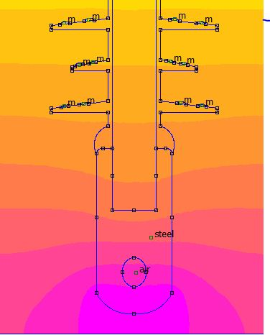
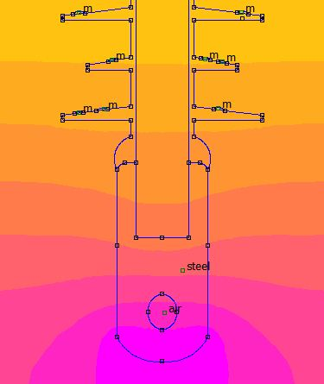
a)Polluted zone
1.With equal water molecules:
2.With unequal water molecules:
Fig33:contours results for equal water molecules
Fig34:contours results for unequal water molecules

Slide 35
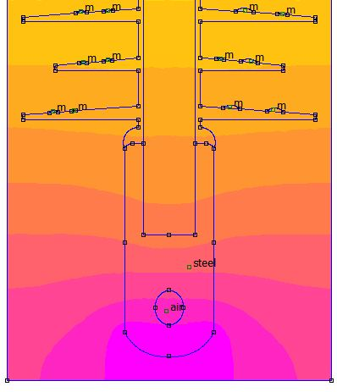
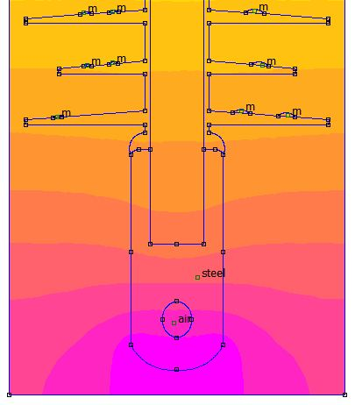
b)Very Heavy Polluted zone
1.With equal water molecules:
2.With unequal water molecules:
Fig35:contours results for equal water molecules
Fig36:contours results for unequal water molecules

Slide 36
EFI Results Comparison:
S.No | particulars | Polluted zone |  | Very heavy polluted zone
 |  | Equal water molecules | Unequal water molecules | Equal water molecules | Unequal water molecules
1 | CD | 0.225 | 0.232 | 0.223 | 0.228
2 | Triple Point | 0.268 | 0.270 | 0.248 | 0.236
3 | First shed | 0.144 | 0.146 | 0.144 | 0.146
Table 14 : EFI results of an insulator with water molecules

Slide 37
Module V
Evaluation of Insulator Performance with water molecules and under various Contaminations

Slide 38
Insulator Performance with water molecules and under various Contaminations:
Case 1)Polluted zone insulator
a)With Salt contamination and equal water molecules
b)With Salt contamination and unequal water molecules
c)With Cement contamination and equal water molecules
d)With Cement contamination and unequal water molecules
e)With Urea contamination and equal water molecules
f)With Urea contamination and unequal water molecules
b)Very heavy polluted zone insulator
a)With Salt contamination and equal water molecules
b)With Salt contamination and unequal water molecules
c)With Cement contamination and equal water molecules
d)With Cement contamination and unequal water molecules
e)With Urea contamination and equal water molecules
f)With Urea contamination and unequal water molecules

Slide 39
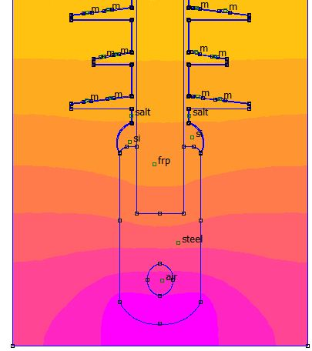
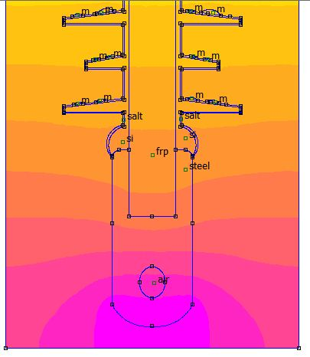
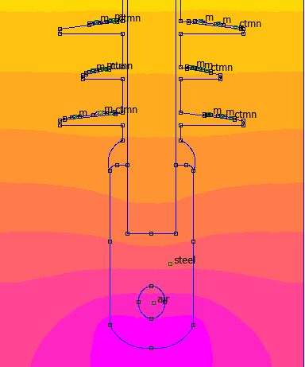
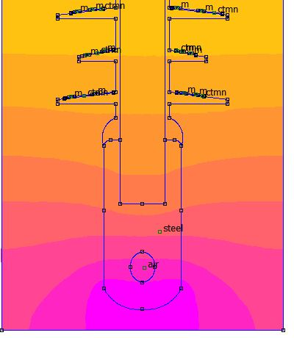
Case1:Polluted zone
a)With Salt contamination and equal water molecules:
Fig 39:contours results for even 1mm ctmn with equal water molecules
Fig 37:contours results for even 0.5mm ctmn with equal water molecules
Fig 38:contours results for uneven 0.5mm ctmn with equal water molecules
Fig 40:contours results for uneven 1mm ctmn with equal water molecules

Slide 40
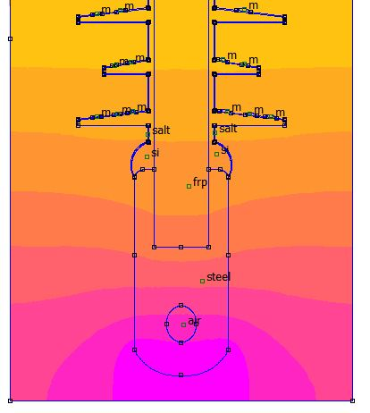
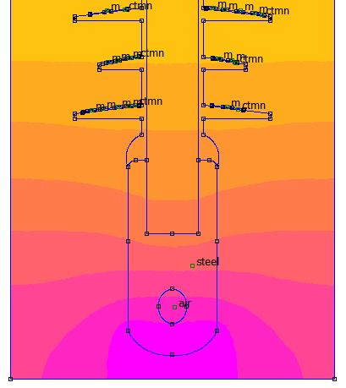
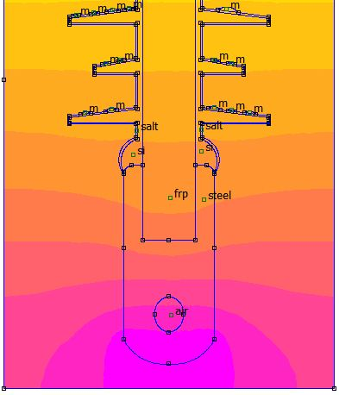
b)With Salt contamination and unequal water molecules
Fig41:contours results for even 0.5mm ctmn with unequal water molecules
Fig 43:contours results for even 1mm ctmn with unequal water molecules
Fig 42:contours results for uneven 0.5mm ctmn with unequal water molecules
Fig 44:contours results for uneven 1mm ctmn with unequal water molecules

Slide 41
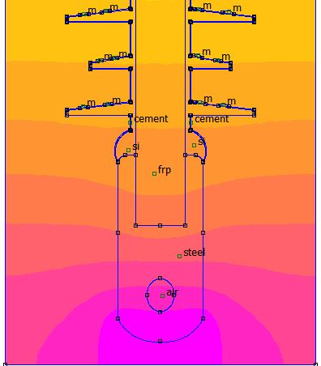
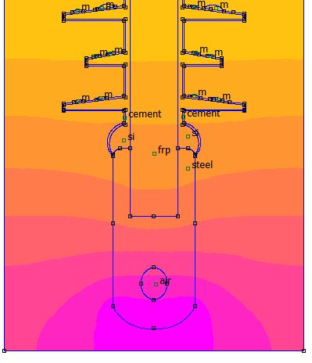
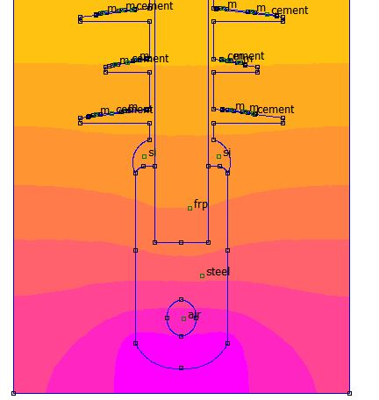
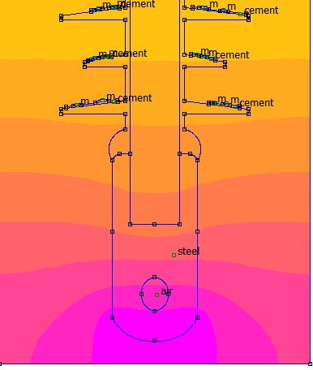
c)With Cement contamination and equal water molecules:
Fig 45:contours results for even 0.5mm ctmn with equal water molecules
Fig 47:contours results for even 1mm ctmn with equal water molecules
Fig 46:contours results for uneven 0.5mm ctmn with equal water molecules
Fig 48:contours results for uneven 1mm ctmn with equal water molecules

Slide 42
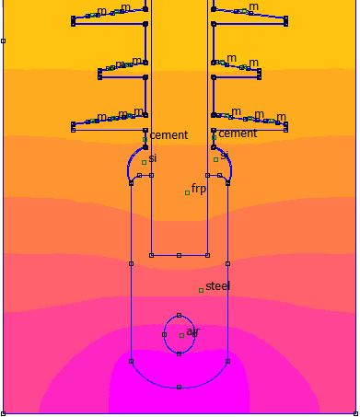
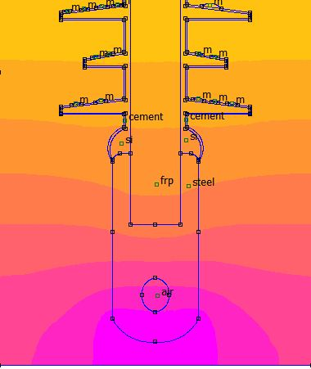


d)With Cement contamination and unequal water molecules:
Fig 49:contours results for even 0.5mm ctmn with unequal water molecules
Fig 51:contours results for even 1mm ctmn with unequal water molecules
Fig 50:contours results for uneven 0.5mm ctmn with unequal water molecules
Fig 52:contours results for uneven 1mm ctmn with unequal water molecules

Slide 43




e)With Urea contamination and equal water molecules:
Fig 53:contours results for even 0.5mm ctmn with equal water molecules
Fig 55:contours results for even 1mm ctmn with equal water molecules
Fig 54:contours results for uneven 0.5mm ctmn with equal water molecules
Fig 56:contours results for uneven 1mm ctmn with equal water molecules

Slide 44




f)With Urea contamination and unequal water molecules:
Fig 57:contours results for even 0.5mm ctmn with unequal water molecules
Fig 59:contours results for even 1mm ctmn with unequal water molecules
Fig 58:contours results for uneven 0.5mm ctmn with unequal water molecules
Fig 60:contours results for uneven 1mm ctmn with unequal water molecules

Slide 45
EFI Results:
s.No | particulars | Salt contamination and Equal water molecules |  |  |  | Salt contamination and Unequal water molecules
 |  | 0.5mm even | 1mm even | 0.5 mm uneven | 1mm uneven | 0.5mm even | 1mm even | 0.5 mm uneven | 1mm uneven
1 | CD | 0.334 | 0.363 | 0.308 | 0.314 | 0.312 | 0.336 | 0.302 | 0.312
2 | Triple Point | 0.129 | 0.115 | 0.273 | 0.273 | 0.127 | 0.116 | 0.260 | 0.274
3 | First shed | 0.166 | 0.175 | 0.168 | 0.167 | 0.166 | 0.174 | 0.166 | 0.167
s.No | particulars | Cement contamination and Equal water molecules |  |  |  | Cement contamination and Unequal water molecules
 |  | 0.5mm even | 1mm even | 0.5 mm uneven | 1mm uneven | 0.5mm even | 1mm even | 0.5 mm uneven | 1mm uneven
1 | CD | 0.245 | 0.245 | 0.253 | 0.259 | 0.235 | 0.240 | 0.252 | 0.261
2 | Triple Point | 0.185 | 0.171 | 0.268 | 0.270 | 0.180 | 0.171 | 0.258 | 0.270
3 | First shed | 0.158 | 0.159 | 0.160 | 0.159 | 0.156 | 0.156 | 0.154 | 0.159
s.No | particulars | Urea contamination and Equal water molecules |  |  |  | Urea contamination and Unequal water molecules
 |  | 0.5mm even | 1mm even | 0.5 mm uneven | 1mm uneven | 0.5mm even | 1mm even | 0.5 mm uneven | 1mm uneven
1 | CD | 0.268 | 0.278 | 0.260 | 0.264 | 0.256 | 0.262 | 0.254 | 0.259
2 | Triple Point | 0.165 | 0.150 | 0.269 | 0.268 | 0.164 | 0.150 | 0.258 | 0.270
3 | First shed | 0.157 | 0.180 | 0.160 | 0.159 | 0.156 | 0.160 | 0.160 | 0.159
Table 15, 16 & 17: EFI results of an insulator with diff contaminations (salt, cement & urea) and water molecules (equal & unequal)

Slide 46




Case2: Very Heavy Polluted zone
a)With Salt contamination and equal water molecules:
Fig 61:contours results for even 0.5mm ctmn with equal water molecules
Fig 63:contours results for even 1mm ctmn with equal water molecules
Fig 62:contours results for uneven 0.5mm ctmn with equal water molecules
Fig 64:contours results for uneven 1mm ctmn with equal water molecules

Slide 47




b)With Salt contamination and unequal water molecules:
Fig 65:contours results for even 0.5mm ctmn with unequal water molecules
Fig 67:contours results for even 1mm ctmn with unequal water molecules
Fig 66:contours results for uneven 0.5mm ctmn with unequal water molecules
Fig 68:contours results for uneven 1mm ctmn with unequal water molecules

Slide 48




c)With Cement contamination and equal water molecules:
Fig 69:scontours results for even 0.5mm ctmn with equal water molecules
Fig 71:contours results for even 0.5mm ctmn with equal water molecules
Fig 70: contours results for even 0.5mm ctmn with equal water molecules
Fig 72:contours results for even 0.5mm ctmn with equal water molecules

Slide 49




d)With Cement contamination and unequal water molecules:
Fig 73:contours results for even 0.5mm ctmn with unequal water molecules
Fig 75:contours results for even 1mm ctmn with unequal water molecules
Fig 74:contours results for uneven 0.5mm ctmn with unequal water molecules
Fig 76:contours results for uneven 1mm ctmn with unequal water molecules

Slide 50




e)With Urea contamination and equal water molecules:
Fig 77:contours results for even 0.5mm ctmn with equal water molecules
Fig 79:contours results for even 0.5mm ctmn with equal water molecules
Fig 78:contours results for even 0.5mm ctmn with equal water molecules
Fig 80:contours results for even 0.5mm ctmn with equal water molecules

Slide 51




f)With Urea contamination and unequal water molecules:
Fig 81:contours results for even 0.5mm ctmn with unequal water molecules
Fig 83:contours results for even 1mm ctmn with unequal water molecules
Fig 82:contours results for uneven 0.5mm ctmn with unequal water molecules
Fig 84:contours results for uneven 1mm ctmn with unequal water molecules

Slide 52
EFI Results:
s.No | particulars | Salt contamination and Equal water molecules |  |  |  | Salt contamination and Unequal water molecules
 |  | 0.5mm even | 1mm even | 0.5 mm uneven | 1mm uneven | 0.5mm even | 1mm even | 0.5 mm uneven | 1mm uneven
1 | CD | 0.300 | 0.338 | 0.296 | 0.307 | 0.292 | 0.334 | 0.283 | 0.298
2 | Triple Point | 0.148 | 0133 | 0.246 | 0.243 | 0.149 | 0.132 | 0.250 | 0.244
3 | First shed | 0.140 | 0.142 | 0.154 | 0.156 | 0.145 | 0.142 | 0.154 | 0.155
S.No | particulars | Cement contamination and Equal water molecules |  |  |  | Cement contamination and Unequal water molecules
 |  | 0.5mm even | 1mm even | 0.5 mm uneven | 1mm uneven | 0.5mm even | 1mm even | 0.5 mm uneven | 1mm uneven
1 | CD | 0.226 | 0.231 | 0.229 | 0.232 | 0.225 | 0.228 | 0.231 | 0.234
2 | Triple Point | 0.186 | 0.177 | 0.224 | 0.241 | 0.186 | 0.179 | 0.253 | 0.243
3 | First shed | 0.140 | 0.141 | 0.147 | 0.148 | 0.145 | 0.140 | 0.190 | 0.150
S.No | particulars | Urea contamination and Equal water molecules |  |  |  | Urea contamination and Unequal water molecules
 |  | 0.5mm even | 1mm even | 0.5 mm uneven | 1mm uneven | 0.5mm even | 1mm even | 0.5 mm uneven | 1mm uneven
1 | CD | 0.246 | 0.256 | 0.244 | 0.249 | 0.248 | 0.258 | 0.247 | 0.253
2 | Triple Point | 0.174 | 0.161 | 0.246 | 0.242 | 0.173 | 0.162 | 0.243 | 0.243
3 | First shed | 0.136 | 0.140 | 0.147 | 0.148 | 0.142 | 0.138 | 0.168 | 0.148
Table 18, 19 & 20: EFI results of an insulator with diff contaminations (salt, cement & urea) and water molecules (equal & unequal)

Slide 53
EFI Results Comparison:
a)Polluted zone:
S.No | Contamination | Equal water molecules |  |  |  | Unequal water molecules
 |  | 0.5mm even | 1mm even | 0.5 mm uneven | 1mm uneven | 0.5mm even | 1mm even | 0.5 mm uneven | 1mm uneven
1 | Salt | 0.334 | 0.363 | 0.308 | 0.314 | 0.312 | 0.336 | 0.302 | 0.312
2 | Urea | 0.268 | 0.278 | 0.260 | 0.264 | 0.256 | 0.262 | 0.254 | 0.261
3 | Cement | 0.242 | 0.245 | 0.253 | 0.259 | 0.235 | 0.240 | 0.252 | 0.258
b)Very Heavy Polluted zone:
S.No | Contamination | Equal water molecules |  |  |  | Unequal water molecules
 |  | 0.5mm even | 1mm even | 0.5 mm uneven | 1mm uneven | 0.5mm even | 1mm even | 0.5 mm uneven | 1mm uneven
1 | Salt | 0.300 | 0.338 | 0.296 | 0.307 | 0.292 | 0.324 | 0.283 | 0.298
2 | Urea | 0.246 | 0.256 | 0.244 | 0.249 | 0.248 | 0.258 | 0.247 | 0.253
3 | Cement | 0.226 | 0.231 | 0.229 | 0.232 | 0.225 | 0.228 | 0.231 | 0.234
Table 21 & 22: EFI results of an insulator with diff contaminations (salt, cement & urea) and water molecules (equal & unequal)
The severity of stress is increase with the combination of contamination and water molecules.

Slide 54
a)Polluted zone insulator with equal water molecules
b)Polluted zone insulator with unequal water molecules
c)Very heavy Polluted zone insulator with equal water molecules
d)Very heavy Polluted zone insulator with equal water molecules

Slide 55
Conclusion:
Based on the simulation results it was concluded that electric field is greatly influenced by pollution layer conductivity and thickness.
As the pollution layer conductivity and thickness increases, EFI increases. The highest EFI observed in the case of 1mm thickness layer.
Salt is the most severe pollution contamination on polymer insulator.
When comes to water molecules on insulator, the stress level depend on the number of droplets, droplet width and diameter of the water droplet.
The severity of electric field stresses greatly increase, if the pollution contamination on insulator is combined with water molecules.

Slide 56
References
M. Chen, T. Wen, W. Jiang and J. Luo, "Modelling and Simulation of New Traction Power Supply System in Electrified Railway," 2015 IEEE 18th International Conference on Intelligent Transportation Systems, Las Palmas, 2015, pp. 1345-1350.
T. Ohashi, Y. Asai, K. Kusagawa, K. Yamamoto and S. Sumi, "Overvoltage Response at Railway Insulators Based on Viaduct Configuration," 2019 11th Asia-Pacific International Conference on Lightning (APL), Hong Kong, 2019, pp. 1-5
Han Se-Won, Cho Han-Goo, Choi In-Hyuk and Lee Dong-Il. Failure characteristics of suspension-type porcelain insulators on a 154 kV transmission line. Electrical Insulation 2006. Proceedings of IEEE International Symposium June 2006, pp118-A.
Verdicchio, P. Ladoux, H. Caron and C. Courtois, "New Medium-Voltage DC Railway Electrification System," in IEEE Transactions on Transportation Electrification, vol. 4, no. 2, pp. 591-604, June 2018.
S. Pastromas, A. Papamikou, G. Peppas and E. Pyrgioti, "Investigation of grounding resistance effect on the MV grid of Hellenic electromotive railway during lightning strikes," 2016 33rd International Conference on Lightning Protection (ICLP), Estoril, 2016, pp. 1-7.
[15] F. Greuter, Y. Dirix, P. Kluge-Weiss, W. Schmidt, and R. Kessler, "Polymer compound with nonlinear current-voltage characteristic and process for producing a polymer compound", United States Patent 7320762, 2008. [16] R. Strumpler and P. Kluge-Weiss, "Smart varistor composites", 8th International Conference on Modern Materials and Technologies (CIMTEC)-World Ceramic Congress & Forum on New Materials, pp. 1522, Montecatini Terme (Italy), 1995.

Slide 57
N. Yoshimura and S. Kumagai "Electrical and environmental aging of silicone rubber used in outdoor instalation”
IEEE Trans. Dielectr. Electr. Insul. vol. 6 pp. 632-650 1999.
J. S. Forest "The performance of high voltage insulators in polluted atmospheres" Proc. of IEEE Winter
Meeting 1969.
Nekahi S. Mcmeekin and M. Farzaneh "Effect of pollution severity on electric field distribution along a polymeric
insulator" 2015 IEEE 11th international conference on the properties and applications of dielectric
materials (ICPADM) 19–22 July 2015.
R.S. Gorur G.G. Karady A. Jagota M. Shah and A.M. Yates "Aging in silicone rubber used for outdoor insulation"
IEEE Transactions on Power Delivery vol. 7 pp. 525-538 April 1992.
H. Gao Z. Jia Y. Mao Z. Guan and L. Wang "Effect of hydrophobicity on electric field distribution and discharges along various wetted hydrophobic surfaces" IEEE Transaction on Dielectrics and Electrical Insulation vol. 15 pp.
435-443 April 2008.
R. Abd-Rahman A. Haddad N. Harid and H. Griffiths "Stress control on polymeric outdoor insulators
using zinc oxide microvaristor composites" IEEE Transaction on Dielectrics and Electrical Insulation
vol. 19 pp. 705-713 April 2012.
Fujimura T. The evolution of porcelain insulator technology in Japan. Electrical Insulation Magazine, IEEE Vol 11,Issue 3, May/Jun 1995 pp26-36.

Slide 58


